Slide 1
Presentation Muniba mazari Presented by Rafay Iftikhar khan Presented to miss qaisra

Slide 2

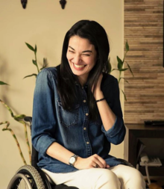
Who is muniba mazari ?
Muniba Mazari Baloch (born 3 March 1987) is a Pakistani activist, anchor artist, model, singer and motivational speaker.
She became the National Ambassador for UN Women Pakistan after being shortlisted in the 100 Inspirational Women of 2015 by BBC. She also made it to the Forbes 30 under 30 list for 2016.
Muniba Baloch is also Pakistan's first model and anchor who uses a wheelchair. She uses a wheelchair due to injuries sustained in a car accident at the age of 21. She appeared as a host on Hum News's social show Main Nahi Hum.

Slide 3
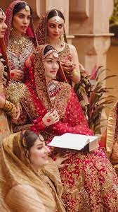
Personal life
Muniba Mazari is from a Baloch background, belonging to the tribe of Mazari.
She was born in Rahim Yar Khan which is in southern Punjab on 3 March 1987.
Muniba went to the Army Public School, and later attended college in her native home town for a BFA.
At the age of 18, before she could complete her studies, she was married.
In 2008, she was involved in an accident, which left her paraplegic.

Slide 4
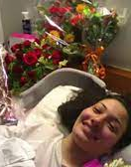
Accident and recovery
On 27 February 2008, Muniba and her husband were travelling from Quetta to Rahim Yar Khan. Their car met with an accident, in which she sustained several major injuries, including broken bones in her arm (both radius and ulna), rib-cage, shoulder blade, collarbone and spine. Her lungs and liver were also deeply cut. Moreover, her entire lower body was left paralyzed. She was taken to a nearby hospital, which was ill-equipped to deal with such a severe case. She was then moved to a hospital in Rahim Yar Khan, and eventually, she was admitted to the Agha Khan Hospital, Karachi Post-surgery, she was left bed-ridden for two years. Physiotherapy started, which helped her recover enough to use a wheelchair..

Slide 5
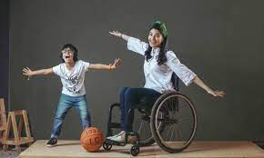
Her son nael
After treatment for her injuries, Muniba moved to Rawalpindi. In 2011, four years after the accident, Muniba adopted her son, Nael.

Slide 6
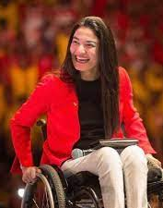
career
Muniba Mazari has gained fame in multiple areas, as an artist, activist, anchor, model, singer and motivational speaker. Most of her career, however, has been built on painting and motivational speaking.
She also started work at her son's school for a startup project called Dheeray Bolo (Speak Slowly), which involved teaching Urdu at various schools. The managing director of Pakistan Television (PTV) at the time, Mohammad Malick, learnt about her because of her TED talk, and asked her to work at PTV.

Slide 7
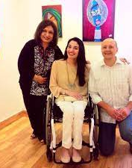
Artist
Muniba started painting on her hospital bed.
Her first International exhibition was held in Dubai - entitled And I Choose To Live - at the Pakistan Association Dubai.
She has displayed her art in several other exhibitions, as well as for charity, including:
USEA Art Club, Islamabad (Solo exhibition)
Nomad Art Gallery (Group exhibition)
Tribal Heritage Art and Craft Gallery, Islamabad (Group exhibition)
My Art World Gallery, Islamabad (Group exhibition)

Slide 8
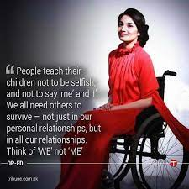
Motivational speaker
She has participated as a motivational speaker on various fronts, with her first break being TED Talks, Islamabad.
Entrepreneurs' Organization Network, Pakistan
Motivational speech at Army Public School, Peshawar and Combined Military Hospital, Peshawar. She also sang Ye Watan Tumhara Hai by Mehdi Hassan
Leader's Summit
Motivational speech at Bank Alfalah Training Centre, Lahore
Invited as a guest to Women Entrepreneurship Day at tnterNational University of Science and Technology Business School
Talked about social entrepreneurship at the Youth Alumni Reunion 2014
Young Presidents’ Organization (YPO).

Slide 9
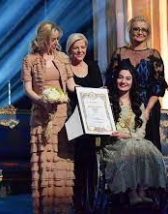
Awards and honors
100 Inspirational Women of 2015 (BBC)
500 most influential Muslims of the world
First Pakistani UN GoodWill Ambassador for UN Women
Forbes 30 Under 30 - 2016
The Karic Brothers Awards 2017 in Serbia by The Karic Foundation
The Karic Brothers Award
Muniba Mazari received Karic Brothers Award in Belgrade, Serbia under the category of humanitarian services.

Slide 10


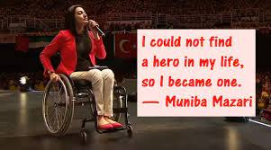
Thank you

